Slide 1
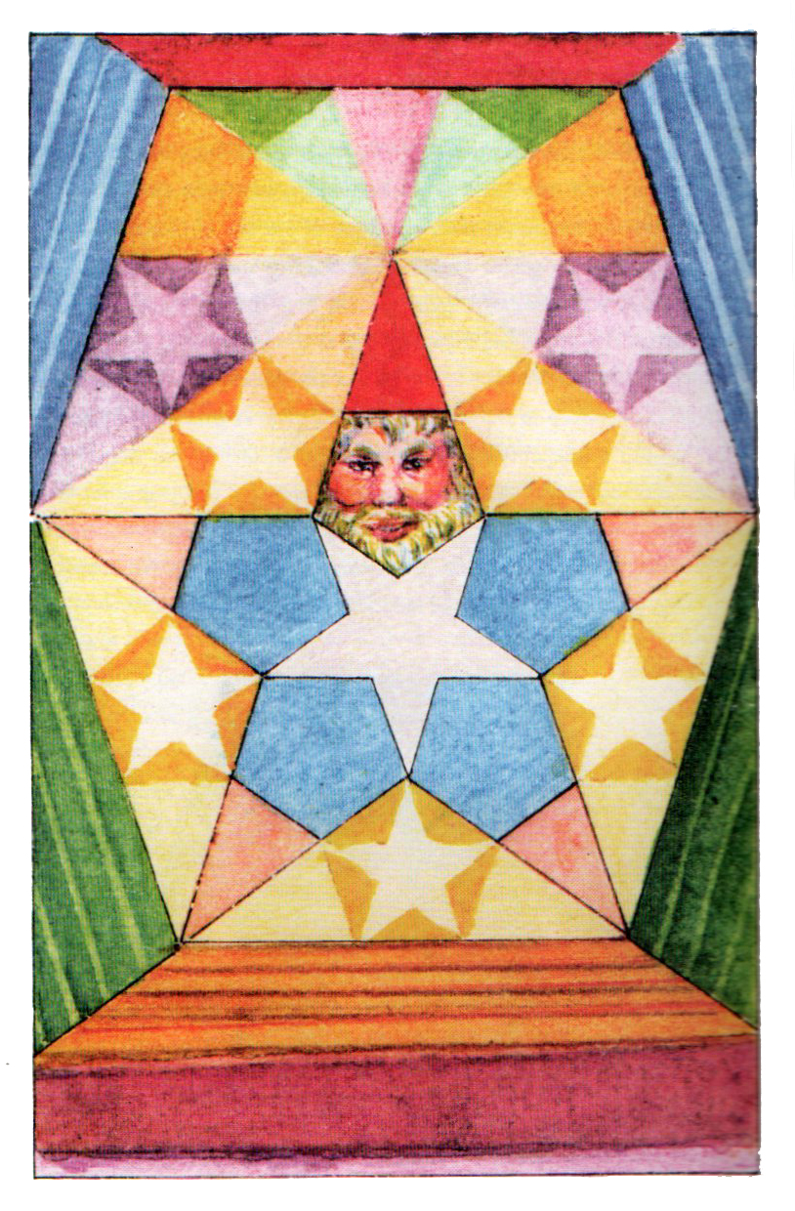
Pentagonal Symmetry
John Michell
Welcome!
Michael S. Schneider
www.constructingtheuniverse.com

Slide 2
You can understand all the designs of the universe if you know about the numbers 1-12
1 2 3 4 5 6 7 8 9 10 11 12
The numbers 1-12
form four groups:
First Principles: 1, 2
Numbers of Structure: 3, 4, 6, 8, 12
Numbers of Life: 5, 10
Numbers of Mystery: 7, 9, 11

Slide 3
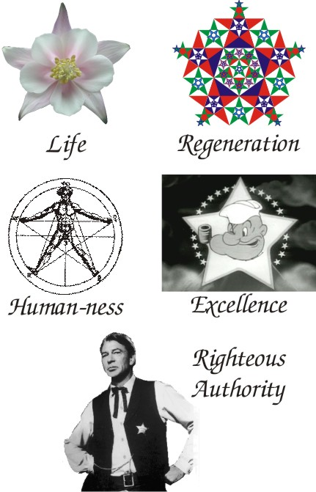
5 as a Symbol
Page 70
Pentagonal Symmetry
Fractal

Slide 4


Excellence!
Not 4-sided,
6-sided, 7 or 8 sided!

Slide 5



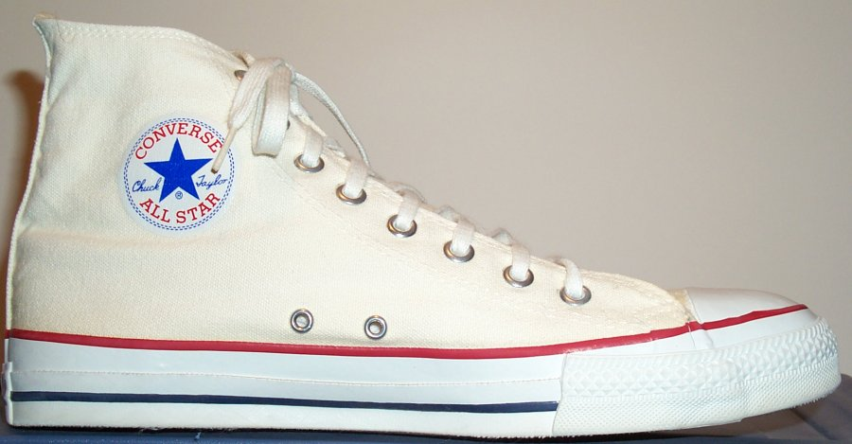
Movie or sports star.
A superstar!

Slide 6



(Righteous) Authority

Slide 7



Slide 8
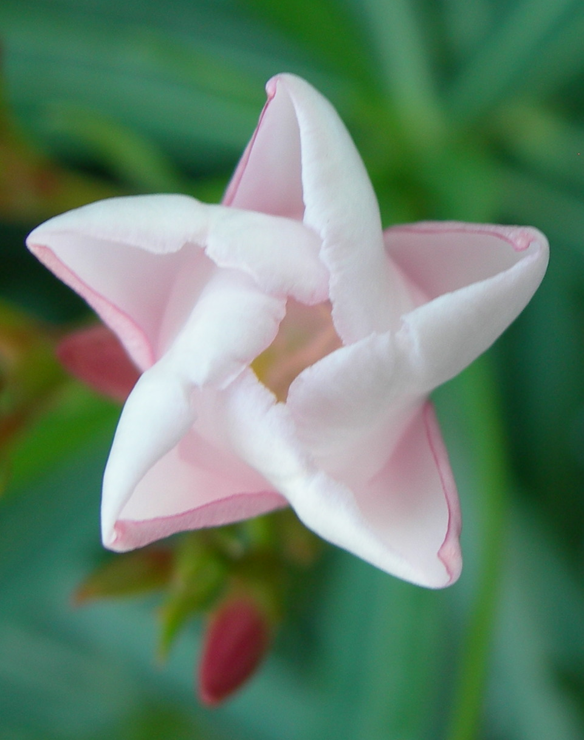
Not just a symbol, but 5 expresses…
Life!

Slide 9
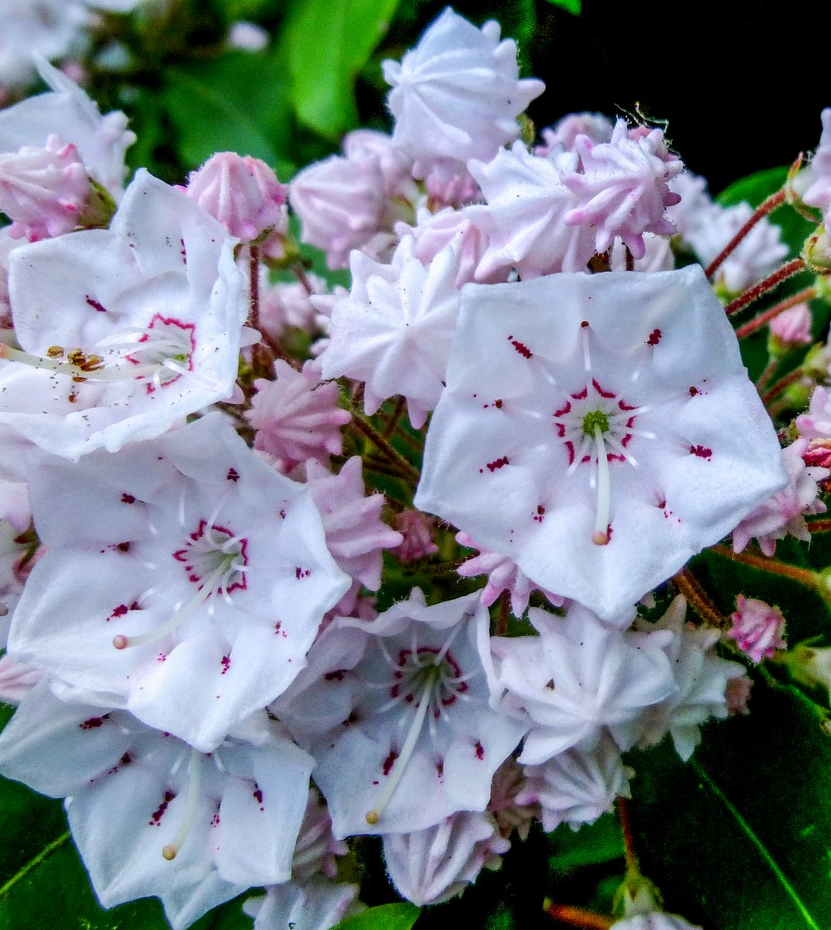
Mountain Laurel

Slide 10
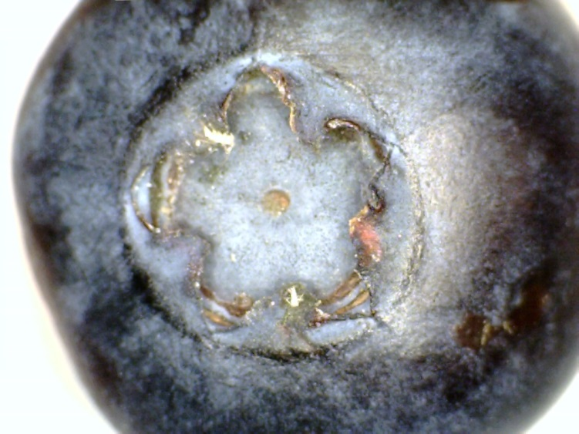
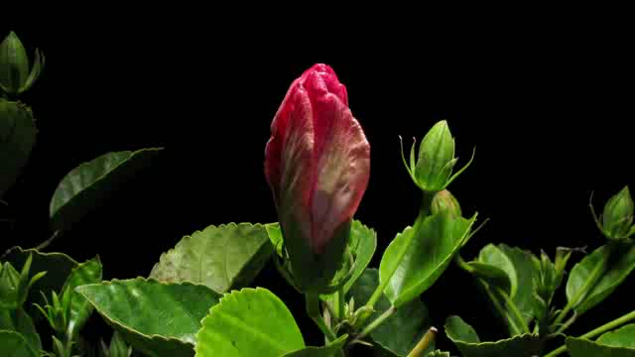

Slide 11
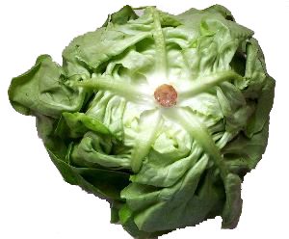

Slide 12
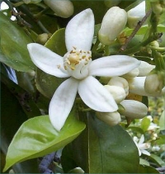
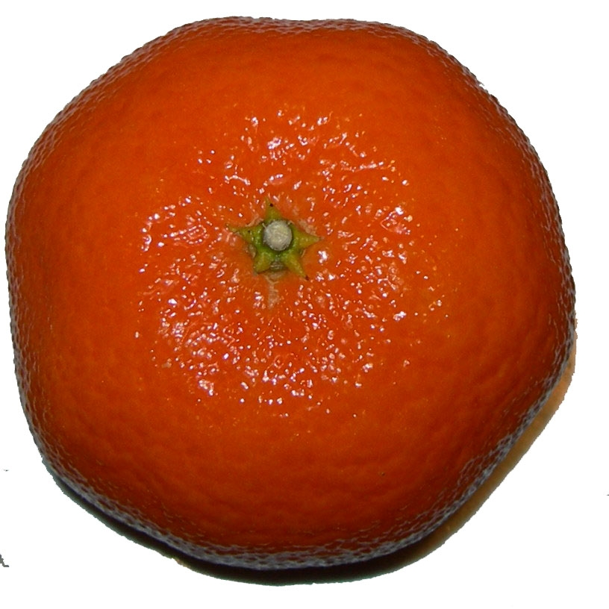
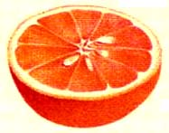
The geometry of the flower
determines
the geometry of the fruit.
2x5=10 sections

Slide 13
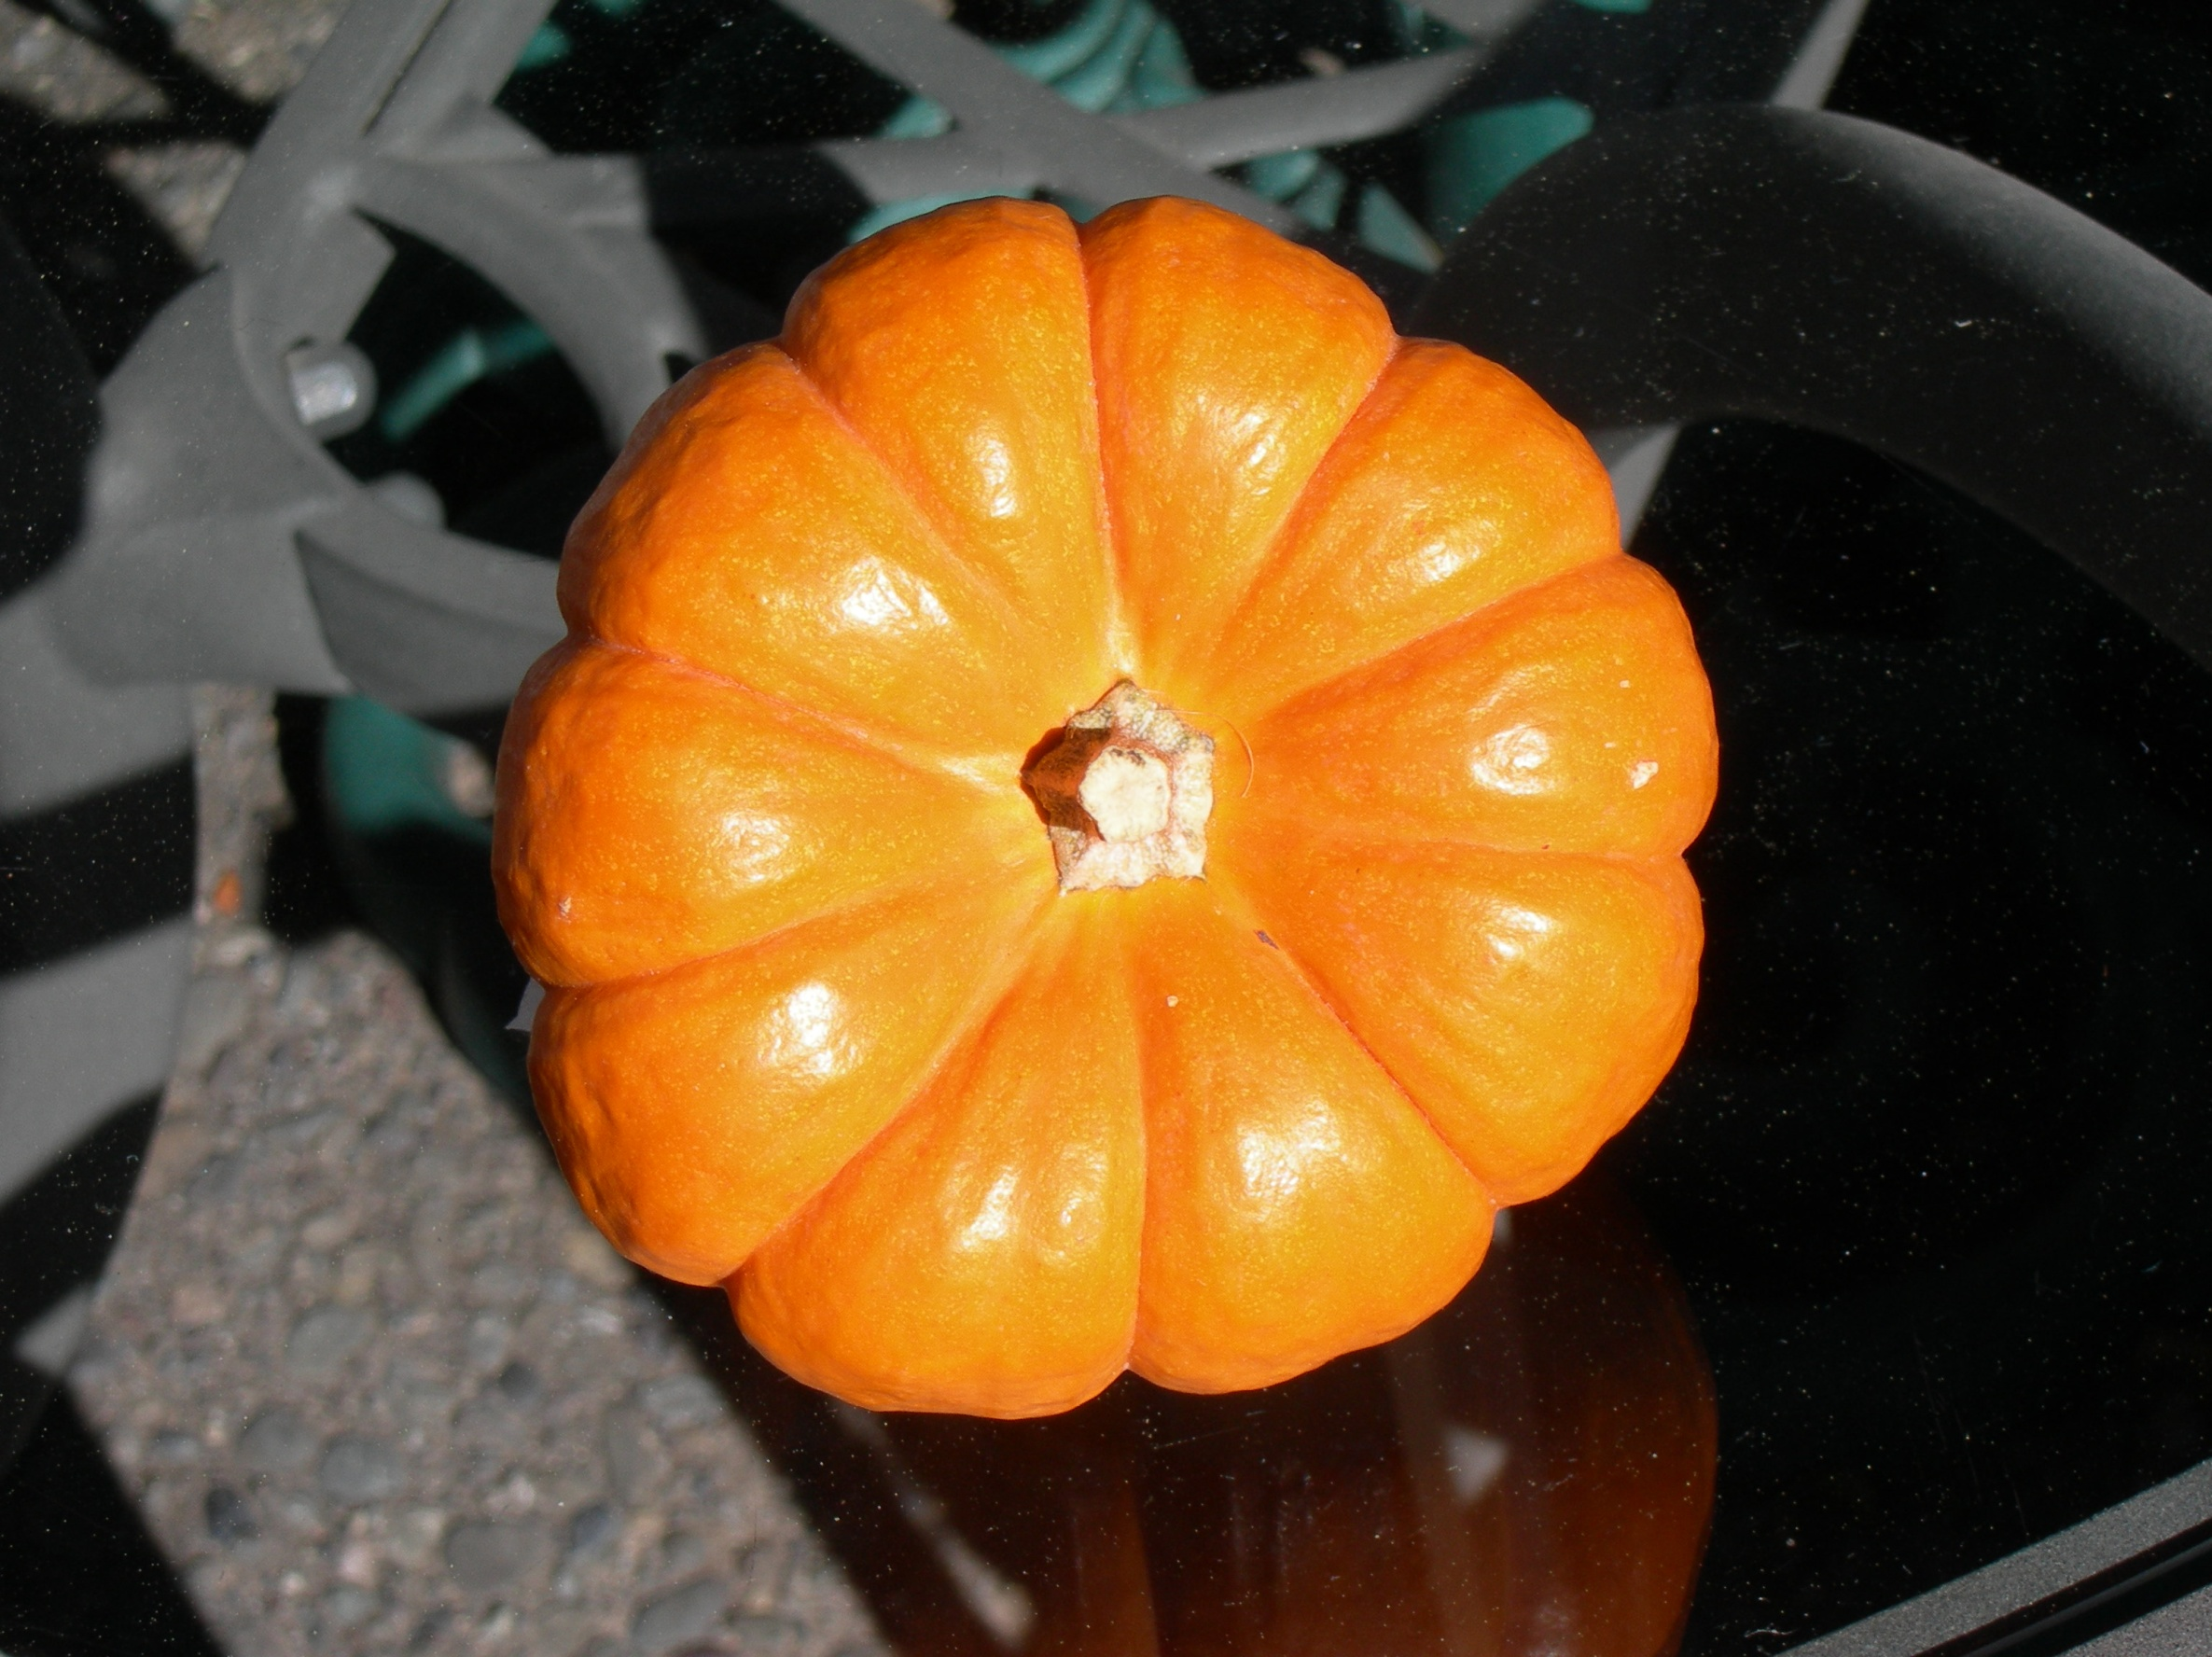
Central Pentagon stem
2x5=10 sections

Slide 14
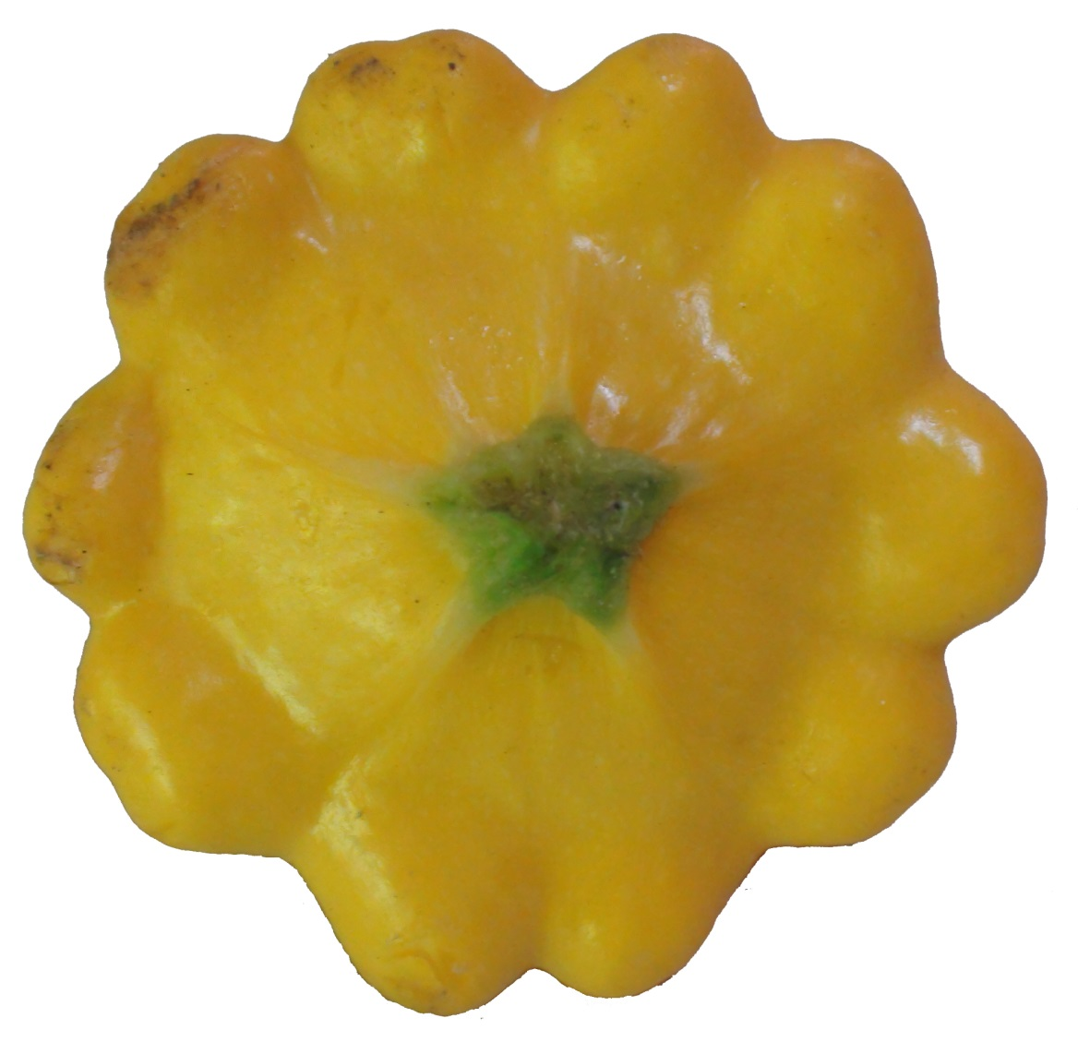
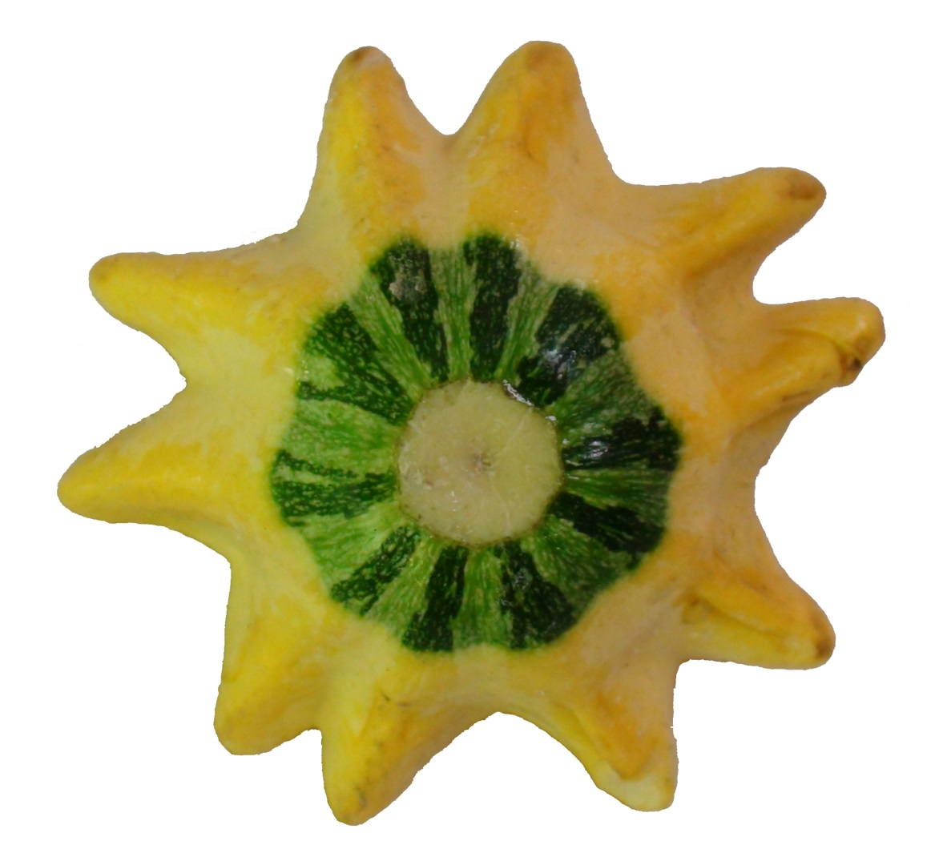

Slide 15
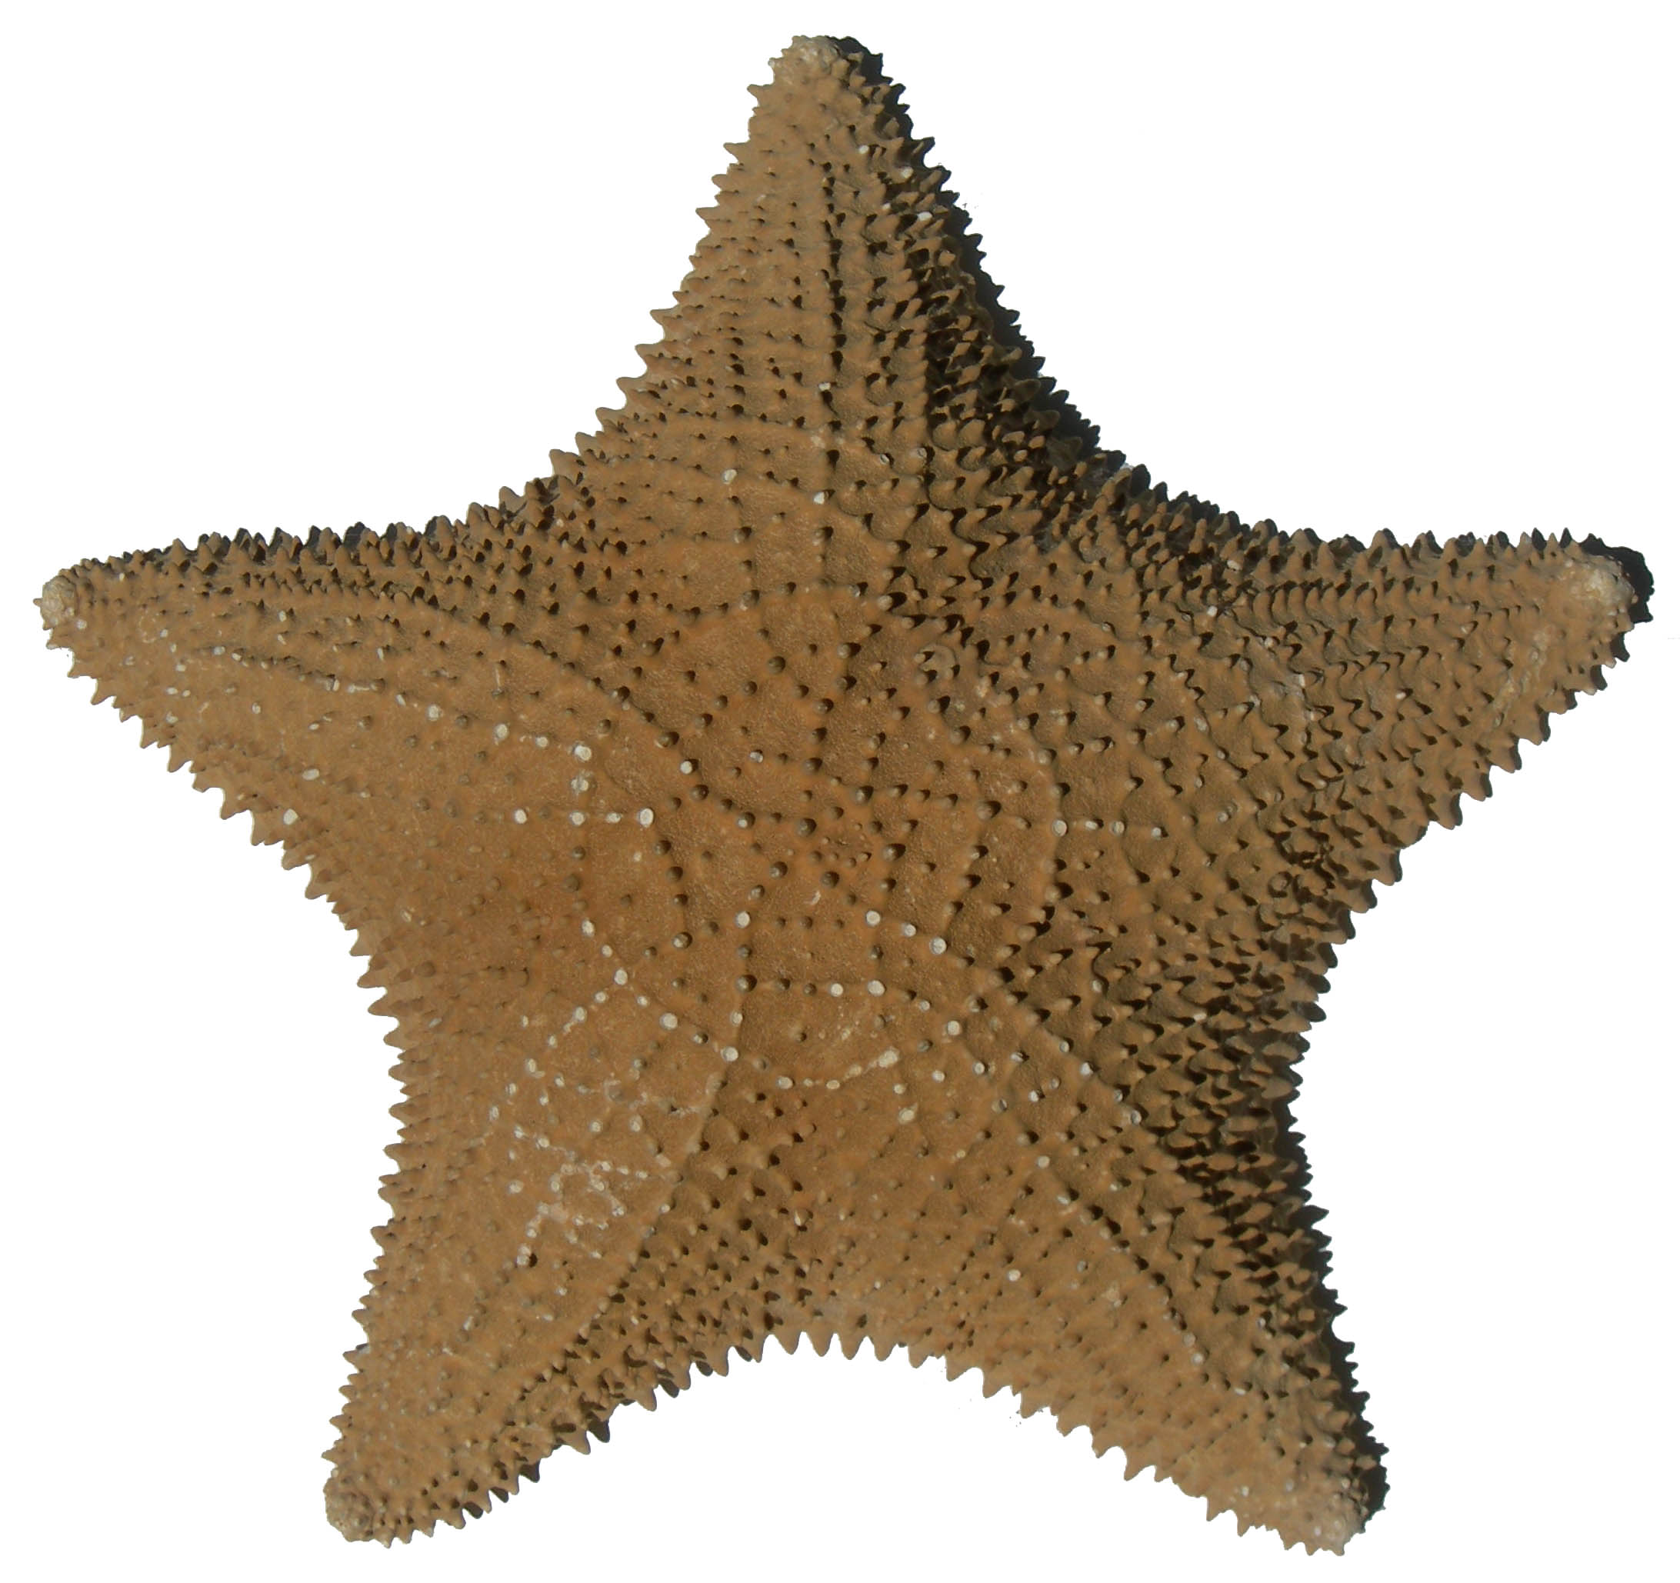
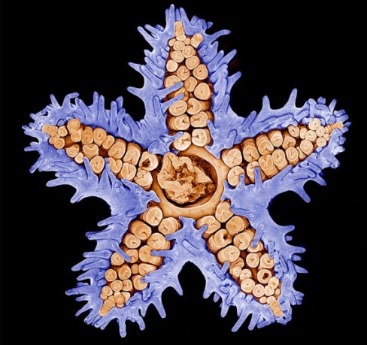
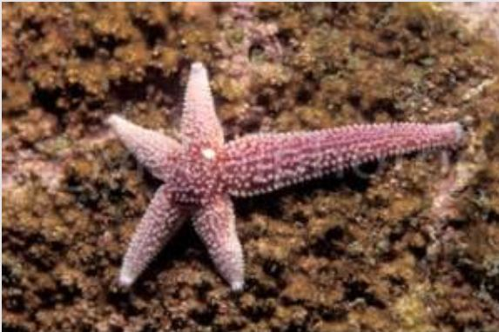
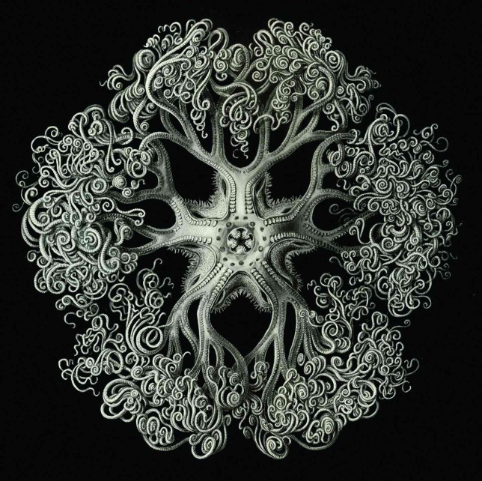


Regeneration

Slide 16
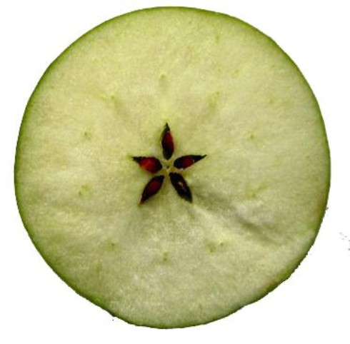
Seed Package: Regeneration
“Anyone can count the number of seeds in an apple,
but no one can count the number of apples in a seed!”
Ralph Waldo Emerson

Slide 17
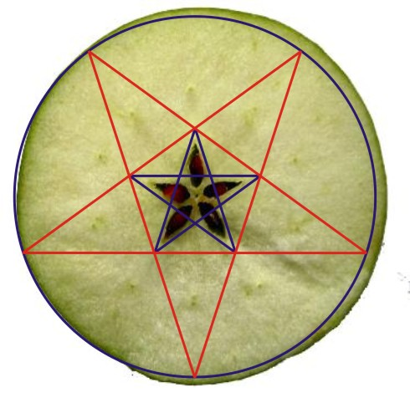

Slide 18
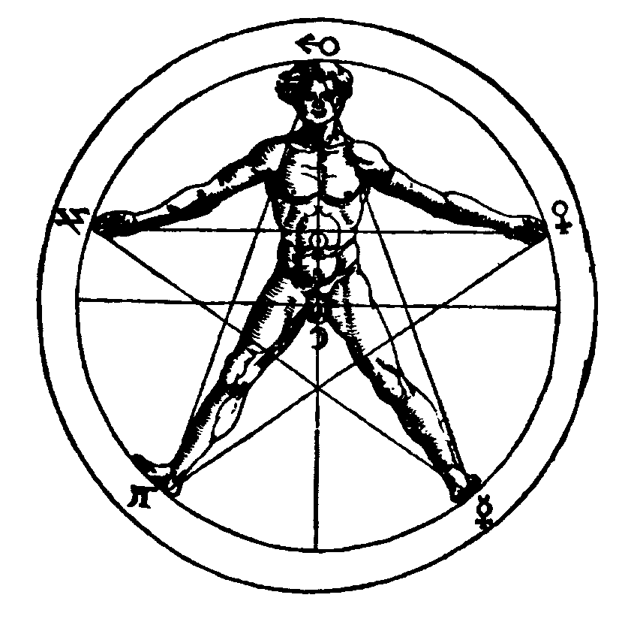
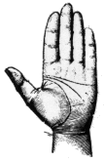
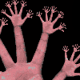
5: Symbol of Humanness

Slide 19
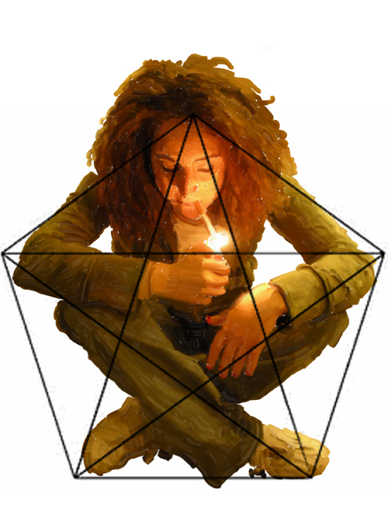
Pentagonal Symmetry is the natural shape of the human form.

Slide 20
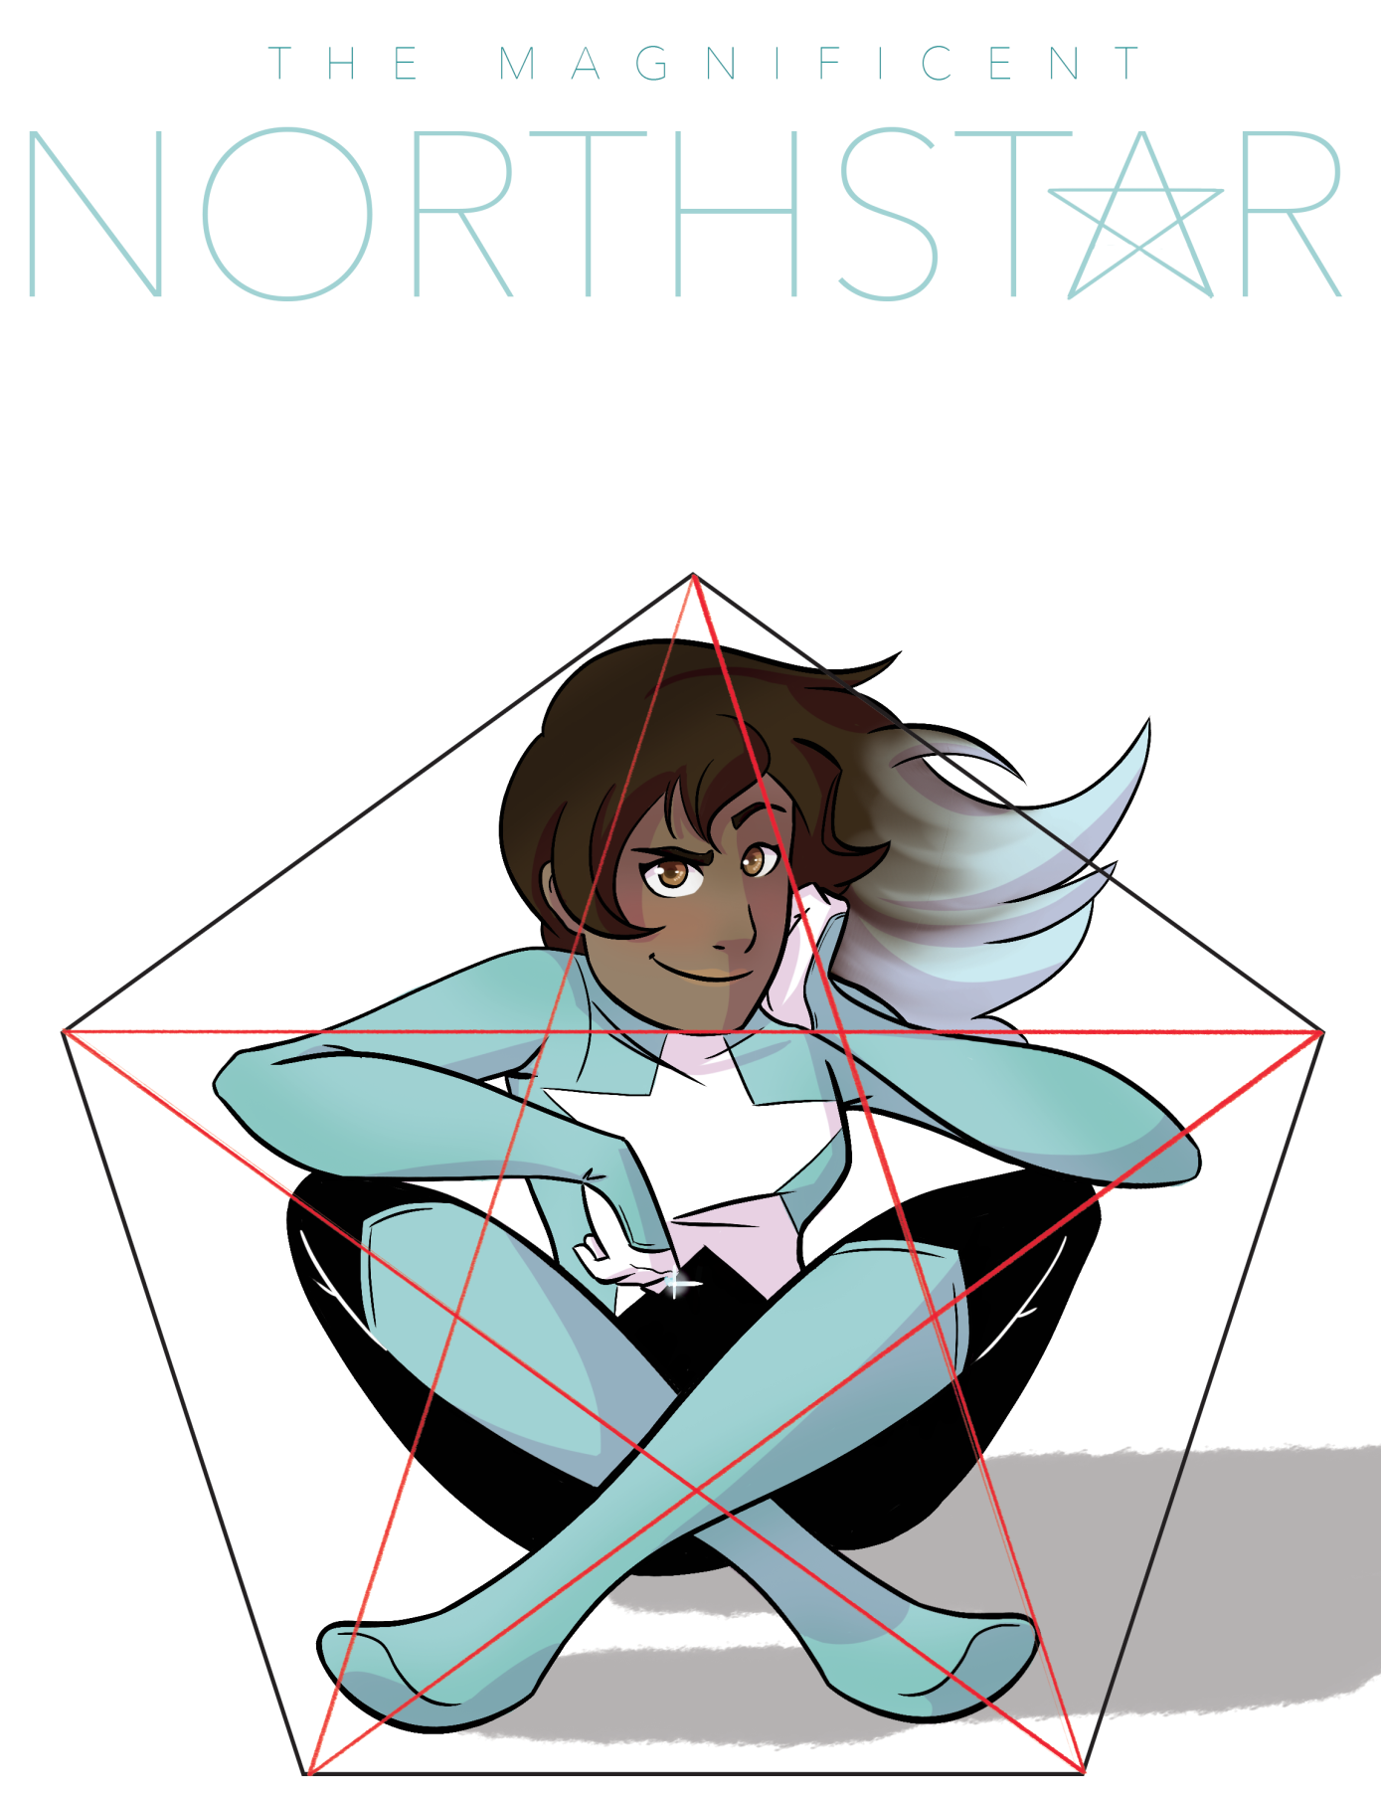

Slide 21
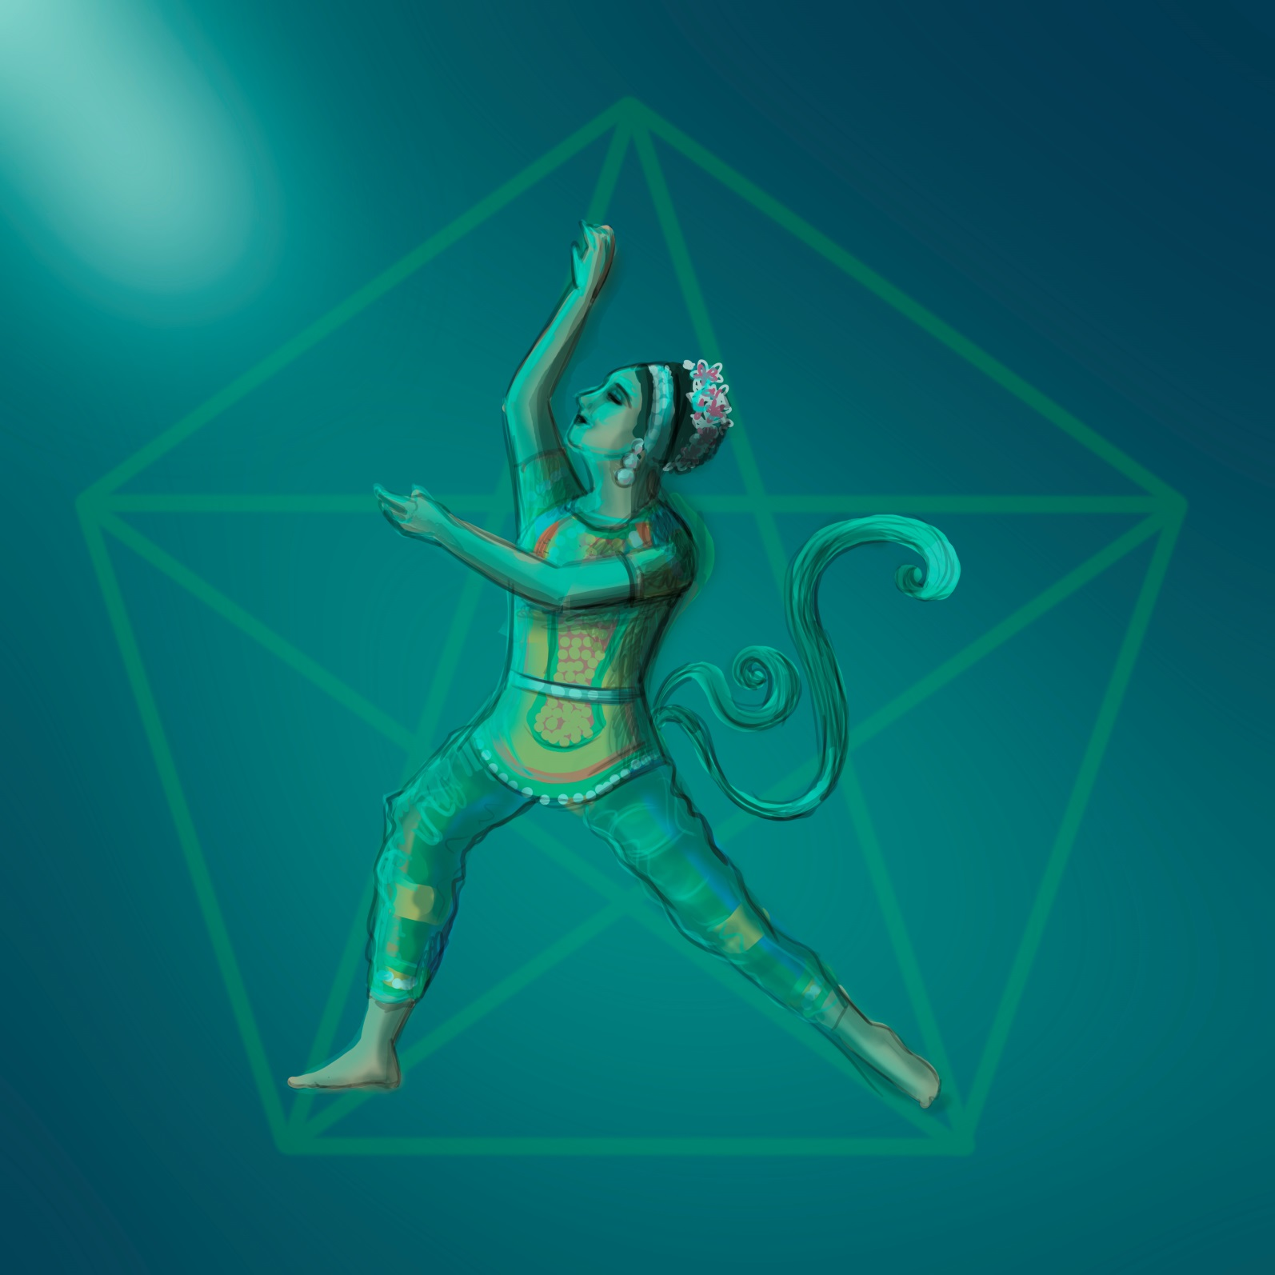
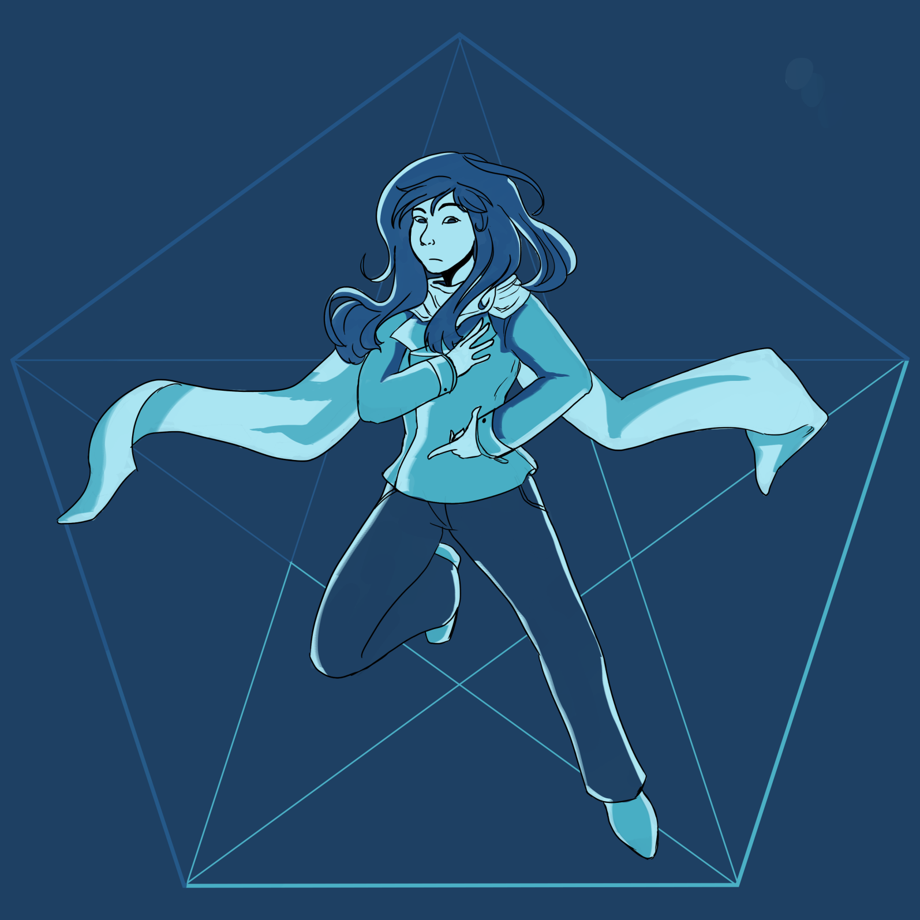

Slide 22
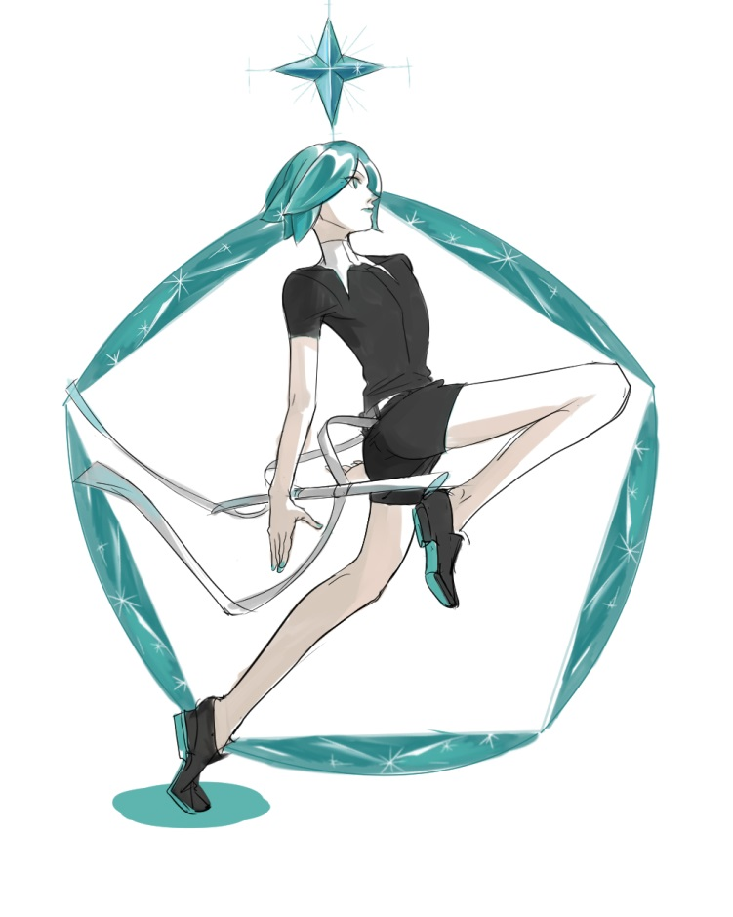
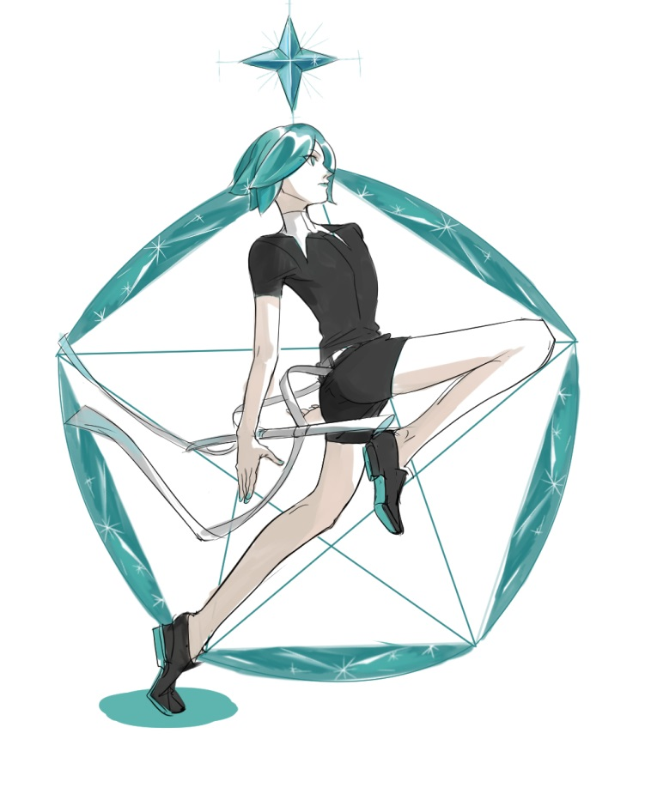

Slide 23
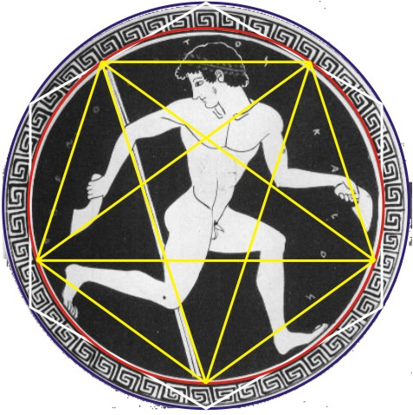
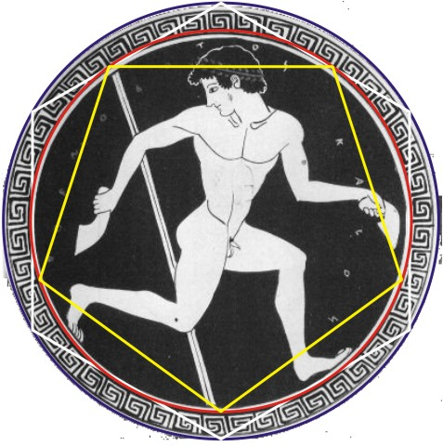
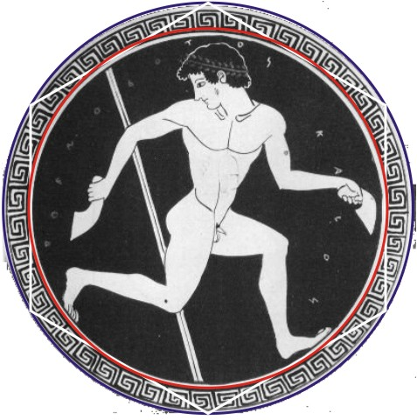
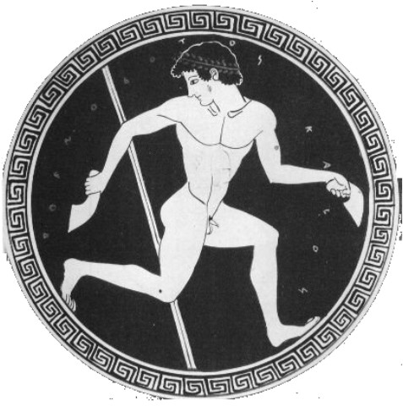
Pentagonal Symmetry
has been used to proportion art and design.

Slide 24
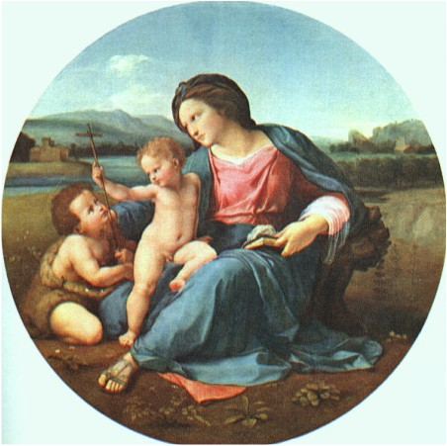
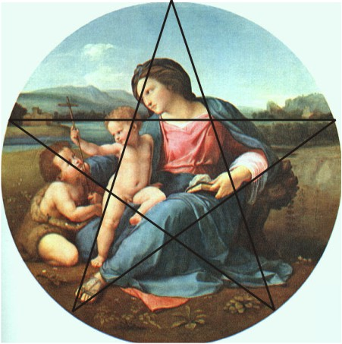
Page 73

Slide 25
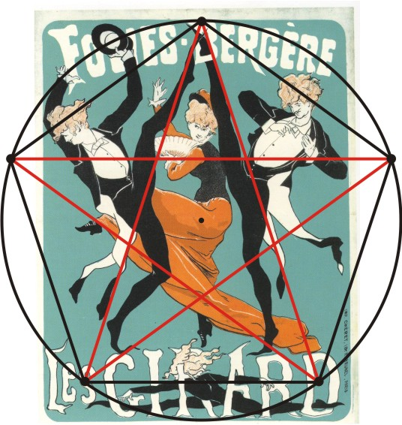
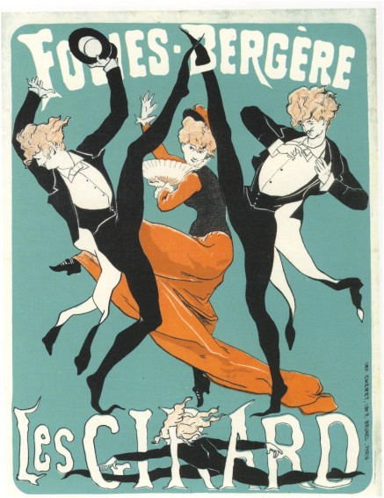
Page 79
Pentagonal symmetry: humanness & joy!
Geometry of Design: Studies in Proportion and Composition
Kimberly Elam

Slide 26
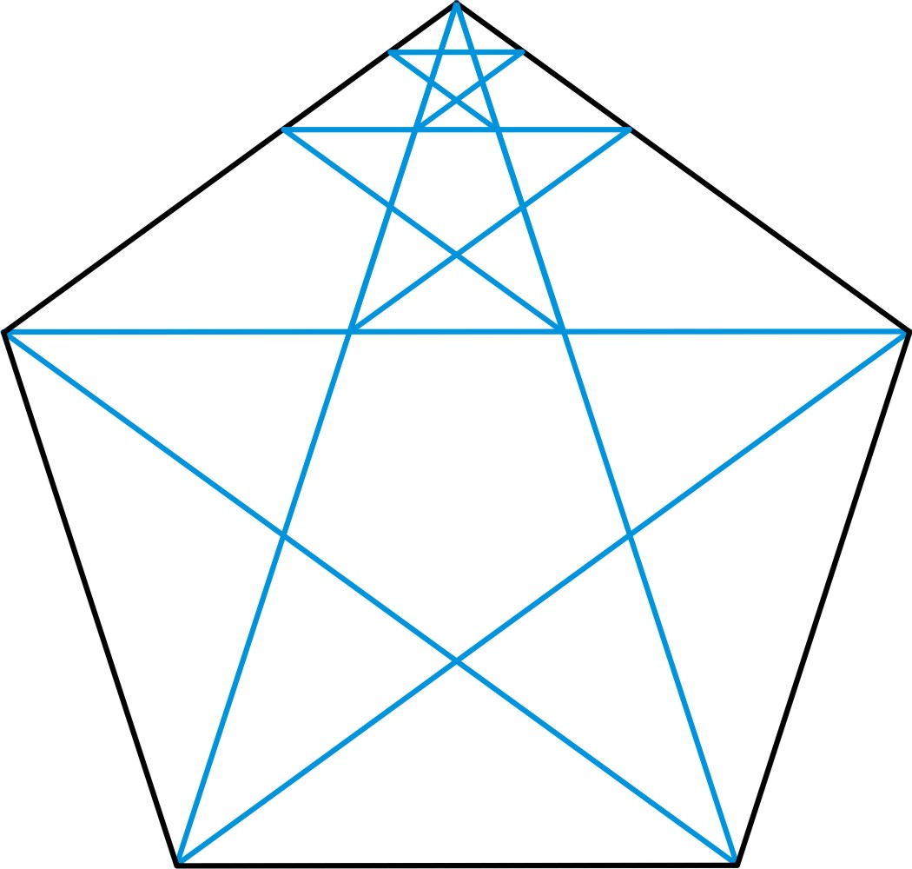
Page 80
A geometric construction
for human body proportions.

Slide 27
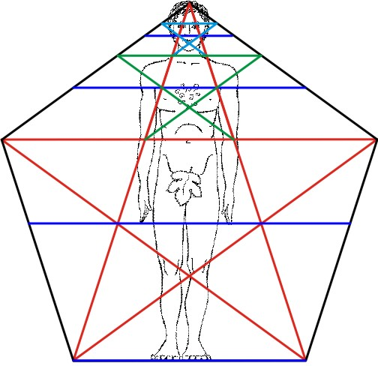
Page 80
Crown
Top of Eyes
Nose
Neck
Armpit
Navel
Reach of Hands
Soles

Slide 28
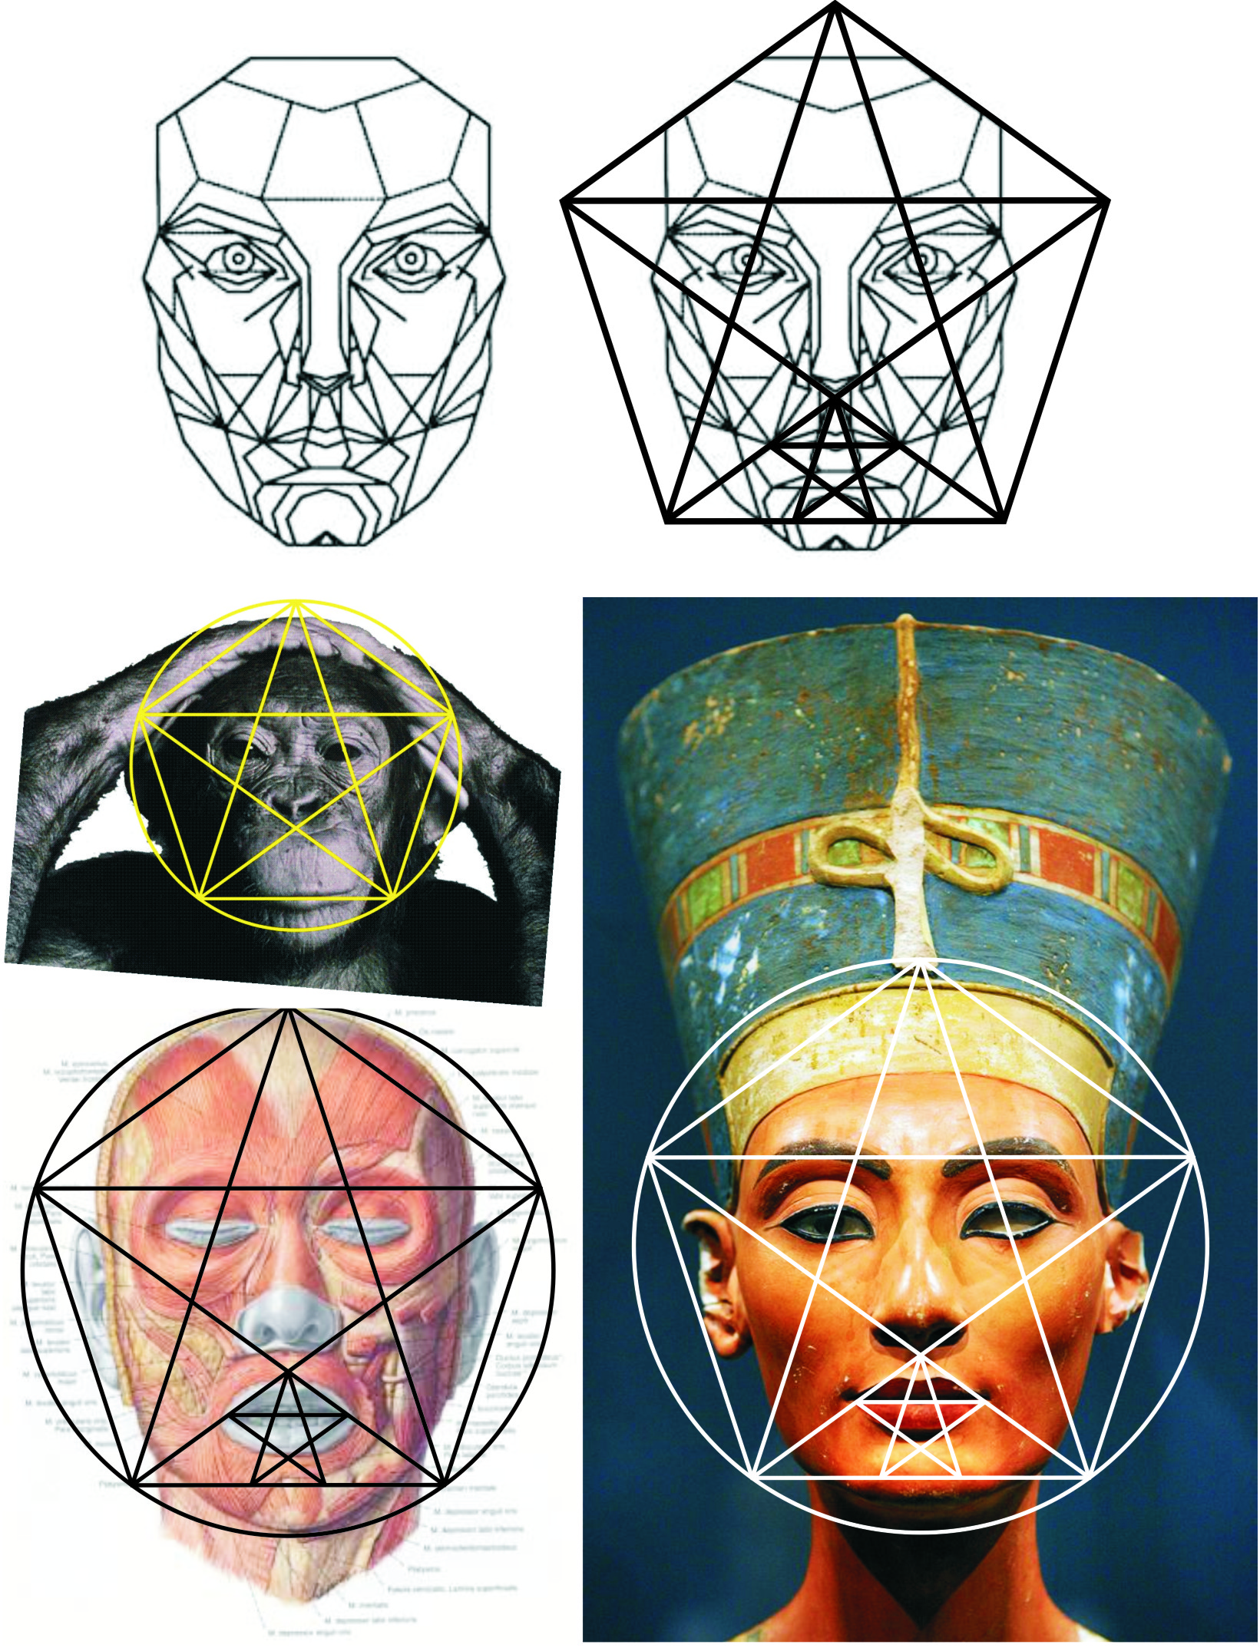

Slide 29
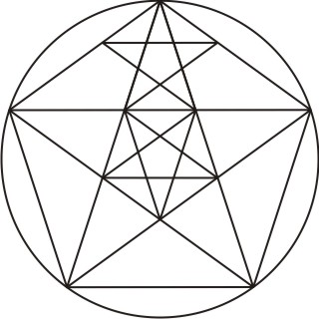
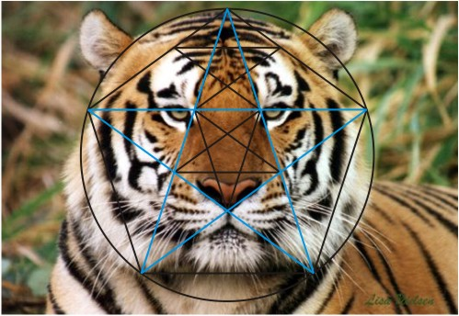
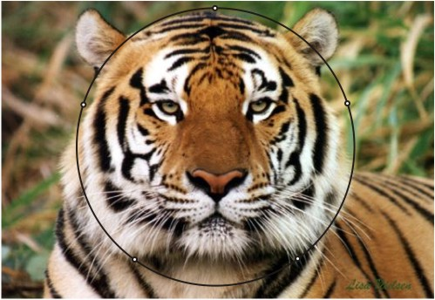

Page 78

Slide 30
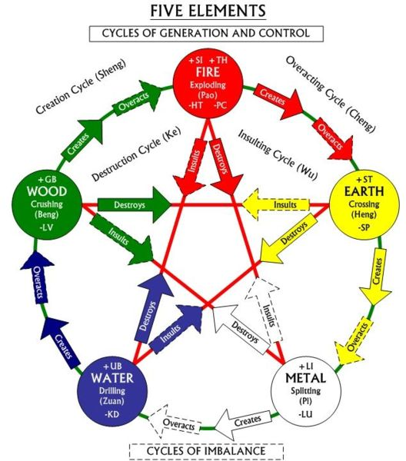
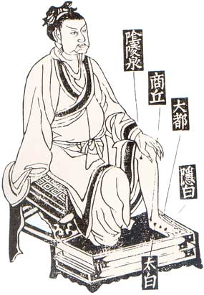
5 Elements of Chinese Medicine
Cycles of Creation & Destruction

Slide 31
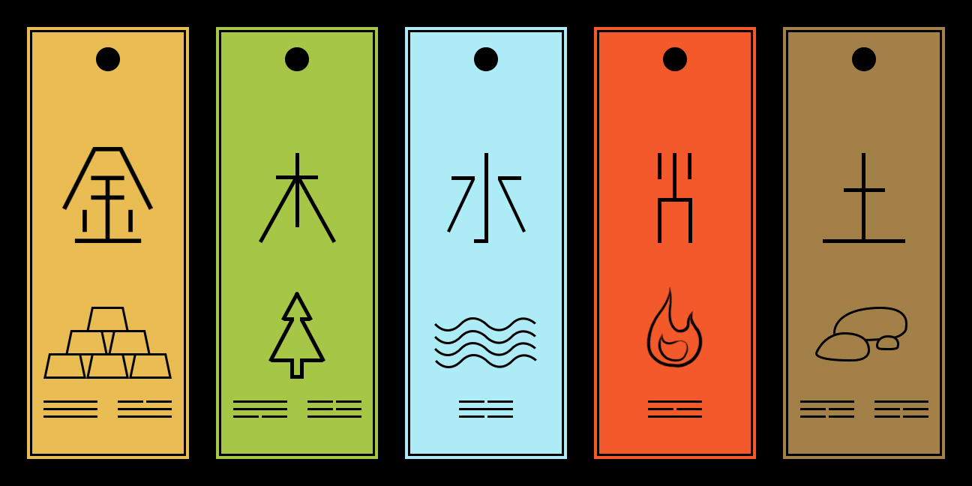

Slide 32
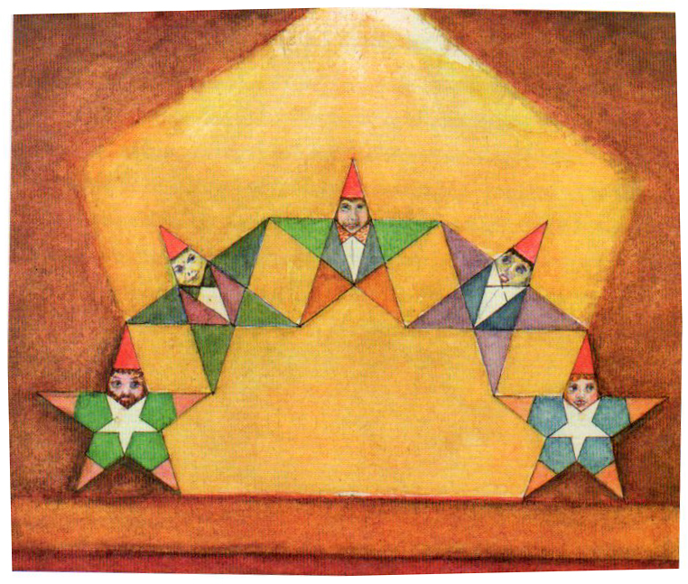
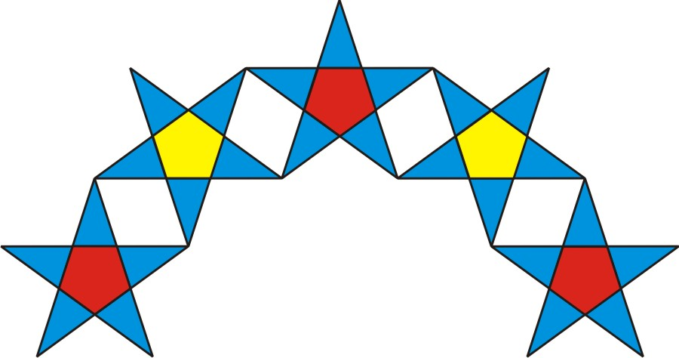
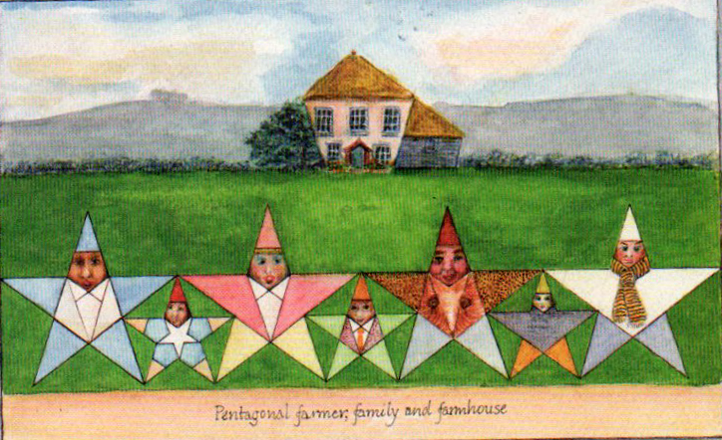
Pentagrams are natural acrobats.

Slide 33
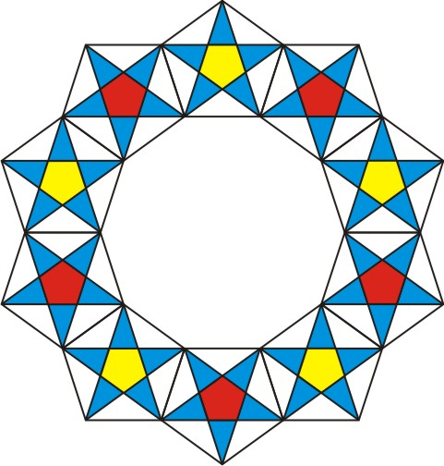
Page 76

Slide 34


Slide 35

Page 71
Constructing a Pentagon
with a Compass and Straightedge
Almond!
Mini-
almond
Walk it around in both directions!

Slide 36


Slide 37


Slide 38


Slide 39

You can turn a full circle or just make an arc.

Slide 40


Slide 41


Slide 42

Mini-Almond

Slide 43


Slide 44


Slide 45


Slide 46

This distance is one side of the pentagon.

Slide 47

“Walk” it around the circle (in both directions) to find the five points.

Slide 48


Slide 49

Open between points to make a curved pentagram.

Slide 50


Page 77
How to construct small stars
within the pentagram’s five corners
(and center)

Slide 51


Slide 52


Slide 53


Slide 54


Slide 55


Slide 56


Slide 57


Slide 58


Slide 60



Cross section of a
Sea Cucumber
(animal)
Page 78

Slide 61


Slide 62




Slide 63

Karl Lorentzen

Slide 64


Slide 65



Slide 66



Slide 67


Slide 68


Iris Han

Slide 69






Slide 70

Annie Johnston
Homework: What can you do with knowledge of 5 as a symbol, as shapes found in nature and in artistic and design composition?

Slide 71
Goodbye!

Slide 73


Slide 74


Slide 75




Slide 76

Opposing ideologies, same star.
Why?

Slide 77


The orbit of Venus as seen from Earth
over 8 years.

Slide 78


Pentagonal symmetry reproduces stars in many sizes without interfering with each other.

Slide 79



Slide 80

Stapelia engleriana

Slide 81

Page 80
Crown
7 Levels of Ideal Human Proportions
(according to the ancient Greeks)
Each two levels add together to equal the next larger one
Top of Eyes
Nose
Neck
Armpit
Navel
Reach of Hands
Soles

